Slide 1

APAC PO Automation App Manual
Alpha V1.4

Slide 2
PO Processing
The Setup
Application Components
User Interface
Procedure

Slide 3

PO processing

Slide 4







PO processing flow
All checking and input by manual
Current manually process
SB1
KAM
CS
PO collection (pdf, xls)
Check PO manually one by one remark corresponding CMMF in the printed PO hardcopy
Create Sales Order line by line manually in SB1
Data mapping and upload file preparation by automation
With PO automation application
1
2
3
4
SB1
CS
PRE-DTW
DTW
PO collection (pdf, xls)
Program step 1
- Consolidate PO list - Data mapping (CMMF, BP Code)
Check and Edit
Program step 2
Create upload file
upload SO by B1 DTW Sales Order Created

Slide 5
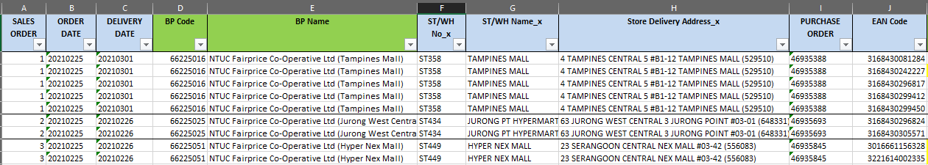
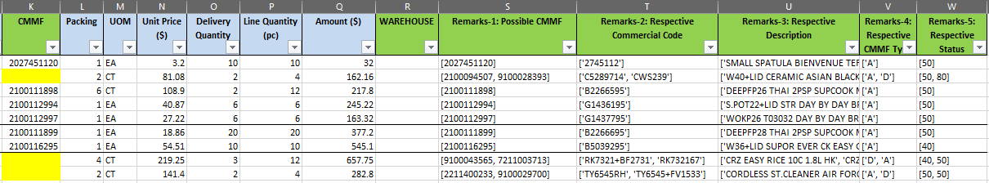
What is PRE-DTW
The 1st output of the program, consolidated the selected PO excel file with data mapping:
CMMF <> EAN code
BP code <> store ID or store name shown in PO
User need to input the missing information (e.g. correct CMMF with duplicate EAN, missing BP code) to go to next step
Column in green – data mapping by program
Column in Blue – direct extract from excel PO

Slide 6
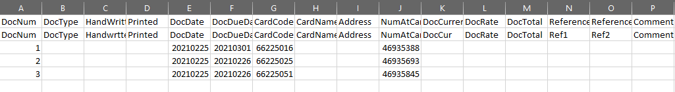
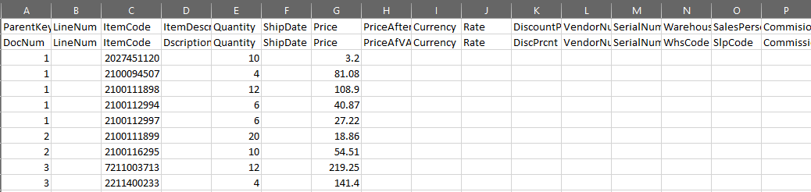
What is DTW
The 2nd output of the program, converted from the PRE-DTW to 2 template file for SB1 upload
PO header
3 customer PO
BP code
PO#
PO line items
CMMF
quantity
Unit price

Slide 7




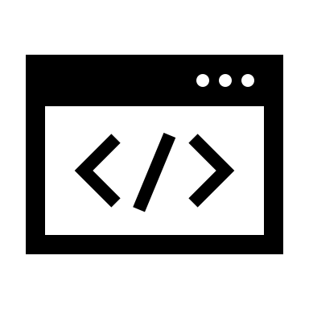
Data Flow
Local PC
Sharepoint
update
BP code master
PO
Customer PO
Automation program
Data collection
Program output
SB1
update
User input
PRE-DTW
DTW

Slide 8

The Setup

Slide 9
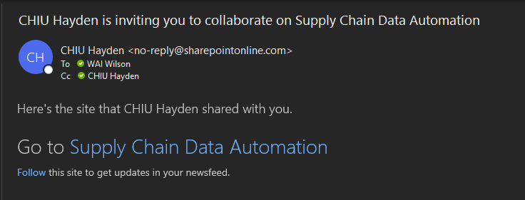
Step 1: Join «Supply Chain Data Automation» Sharepoint

Slide 10
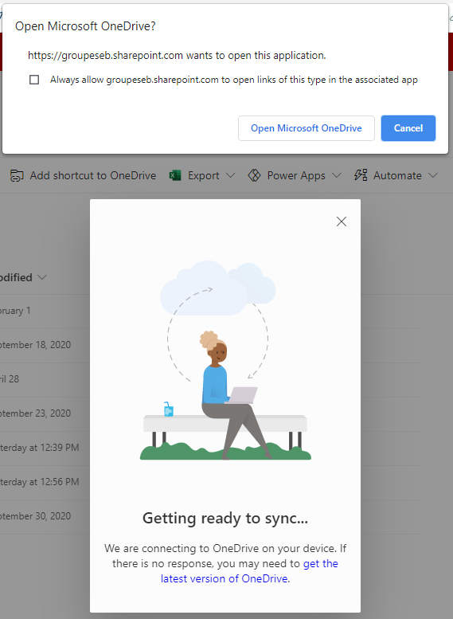
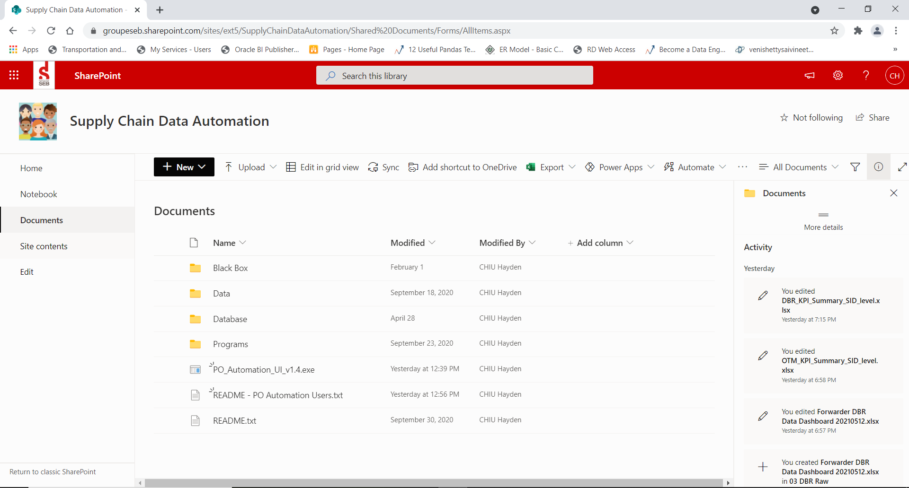
Step 2: Synchronize The Directory to User’s Local PC
2. Click Open Microsoft OneDrive
1. Click Sync Button

Slide 11
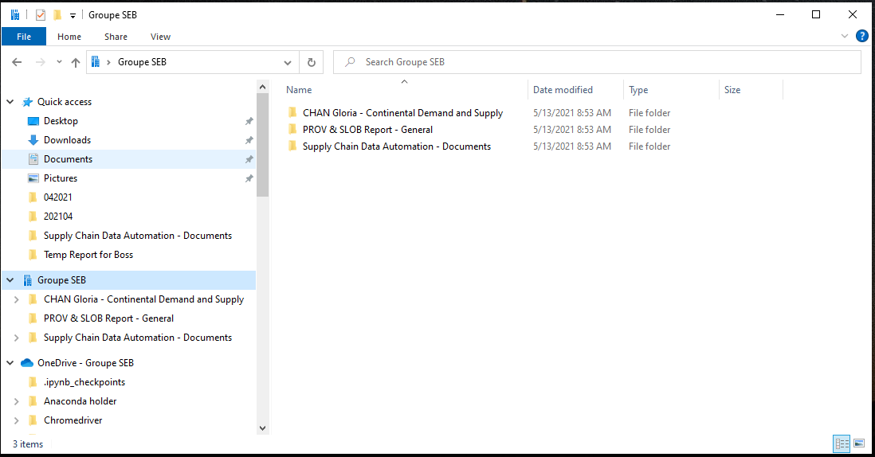
Step 3: Redirect to <Supply Chain Data Automation - Documents>
1. Locate “Supply Chain Data Automation - Documents”

Slide 12
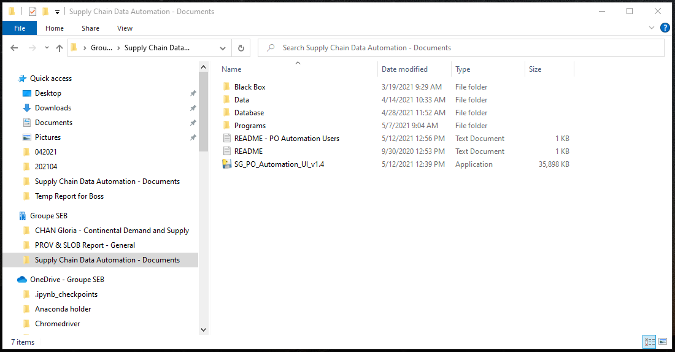
Step 4: Identify the Application by Market

Slide 13

Application Components

Slide 14
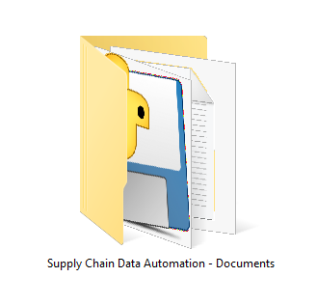
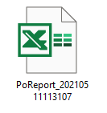
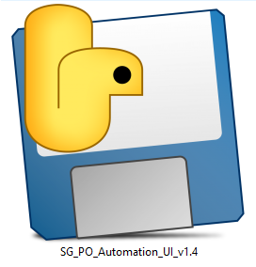
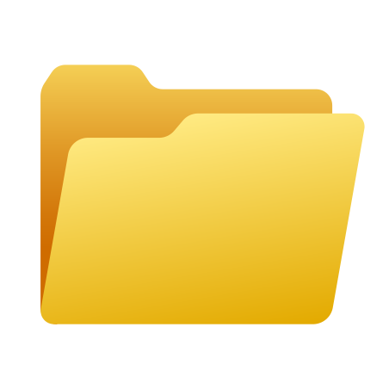
Key Components of The Program
Sharepoint Folder
MLA Source POs
Input
Executable
Output Folder*
Processing
Output
Remark*: Output Folder is in Sharepoint Folder, organized by <Market>/<MLA>/<Date>/<Session ID>

Slide 15
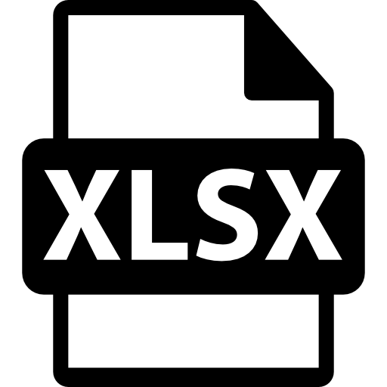
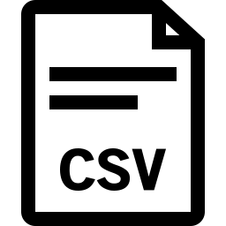
More About The Output Folder Structure
Supply Chain Data Automation - Documents
Data
16 Centralized PO Automation
<Market>
e.g. 066 Singapore
<MLA>
e.g. NTUC
<Date>
e.g. 20210512
<Session ID>
e.g. 3c5e9e61-3fa8-4ade-93e9-2eb6d0a78e60
consolidated_pre_dtw_so
ordr_batch_upload
rdr1_batch_upload

Slide 16

User Interface

Slide 17
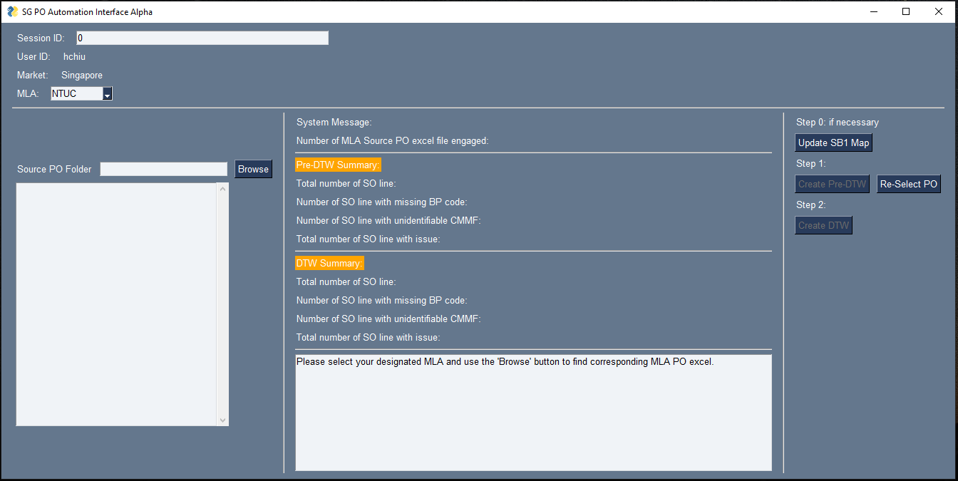
Get to Know the Graphical User Interface
Section 1: Basic Information
Section 3:
System Messages
Section 4:
Control Panel
Section 2:
Source PO Browser

Slide 18
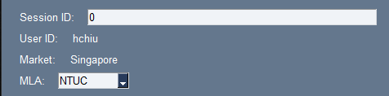
Section 1: Basic Information
Session ID*: The identification number of the current running batch of PO files. (program generated)
User ID: The current user
Market: The market this program is supporting
MLA: Users may choose their corresponding MLA
Remark*: Session ID makes sure the program can identify the same batch of file across the 2 steps process of transforming Source PO files to Pre-DTW to DTW.

Slide 19
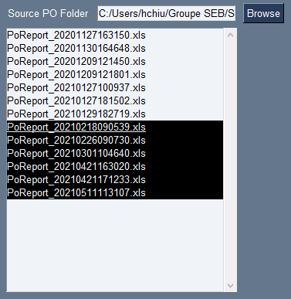
Section 2: Source PO Browser
Browse Button: Choose a directory that saved the Source PO files from MLA.
List Box: Users could highlight the Source PO files they would like to transform.

Slide 20
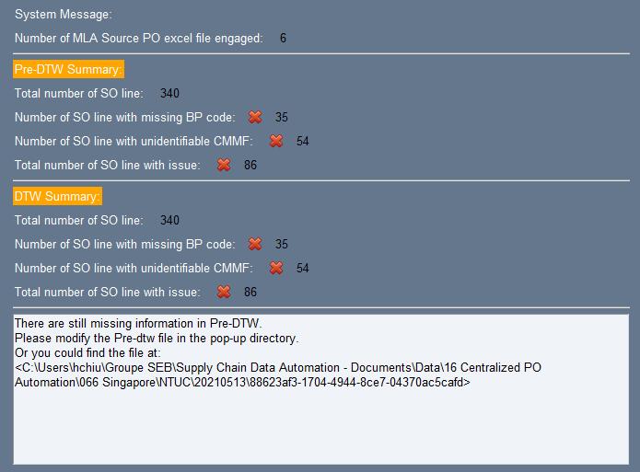
Section 3: System Message
3A: Showing the number of Source PO files selected in section 2.
3B: Showing the count of issues to be fixed in Pre-DTW.
3C: Showing the count of issues remaining after modifying Pre-DTW.
3D: Detail system message/reminder across all steps.
A
B
C
D

Slide 21
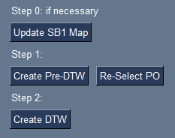
Section 4: Control Panel
Update SB1 Map: A pop-up directory with an excel file that saved MLA store code and BP Code map. User could update the map when necessary.
Create Pre-DTW: After selecting Source PO files in Section 2, clicking this button will start a Session and create a Pre-DTW excel in a pop-up directory for user to edit.
Create DTW: After creating and modifying (fill in missing information) Pre-DTW, clicking this button will create RDR1 and ORDR csv in the same pop-up directory for SB1 DTW upload.
Re-Select PO: End current session and make Section 2 available again for some other batch of source PO files selection.

Slide 22

Procedure

Slide 23


Step 0: Make Sure Your OneDrive is Synchronized and Ciso VPN is Connected (if you work away from office)

Slide 24
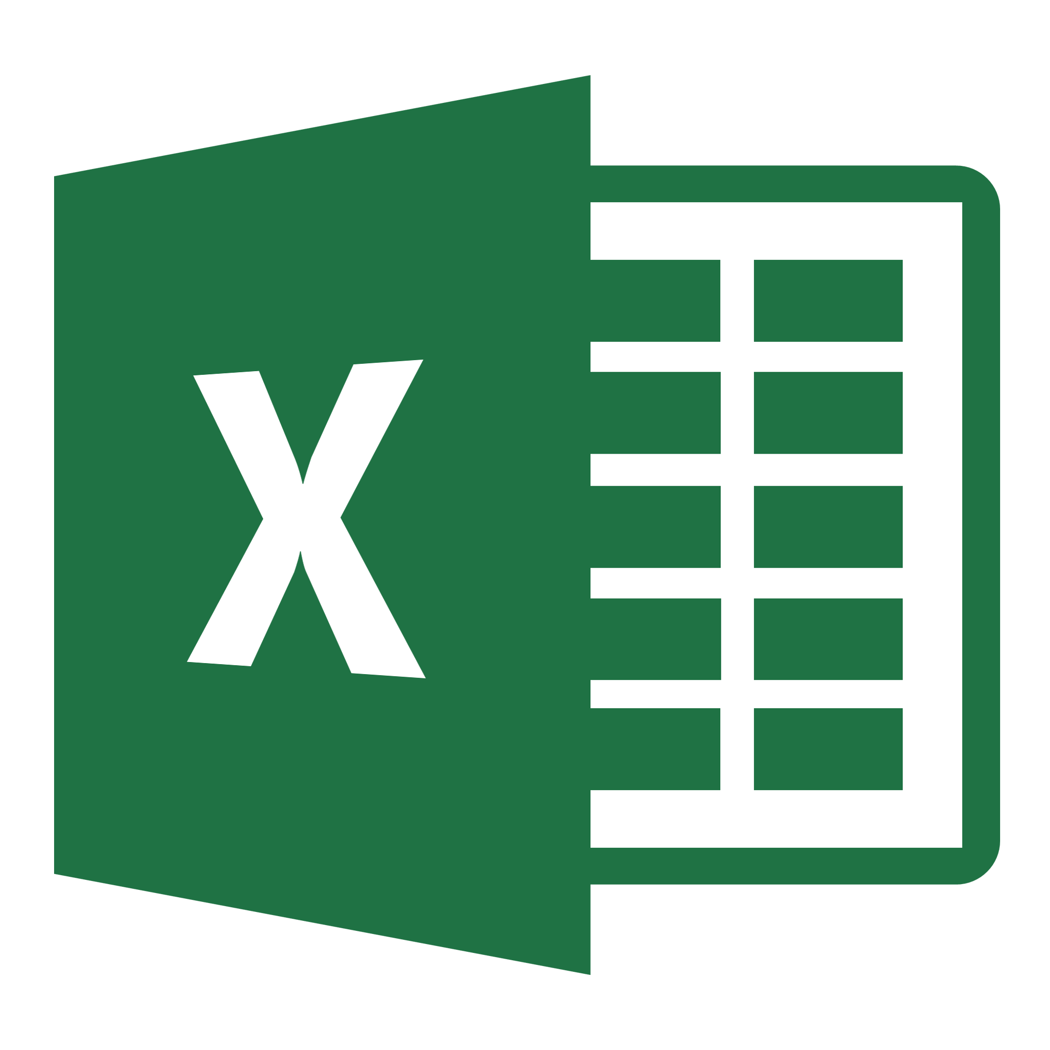


Step 1: Download the Source PO files from MLA Portals
Source PO files
MLA’s Portal
Folder on User’s Local PC

Slide 25

Step 2: Open the Application From Sharepoint Directory
1
Double-Click!

Slide 26
Step 3: Choose the Designated MLA
1

Slide 27
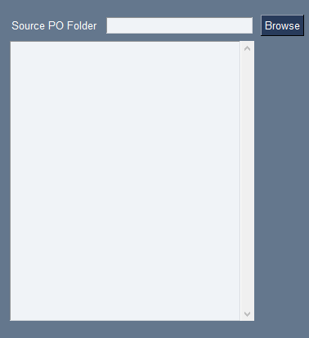
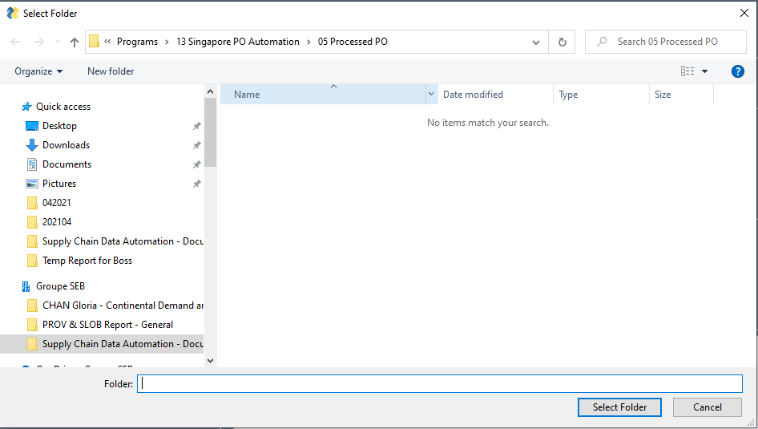
Step 4: Browse Source PO files
1
2
Find the folder that saved your Source PO files.
3

Slide 28
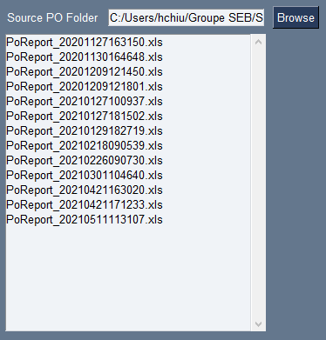
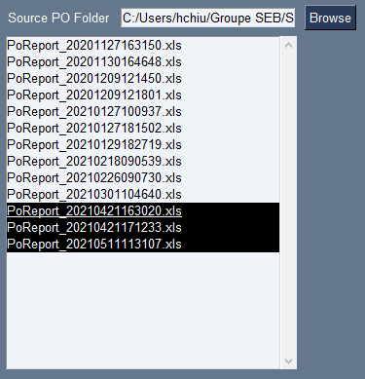


Step 5: Select Source PO files
3
The count will update along the way.
2
1
Click and drag to select the files

Slide 29

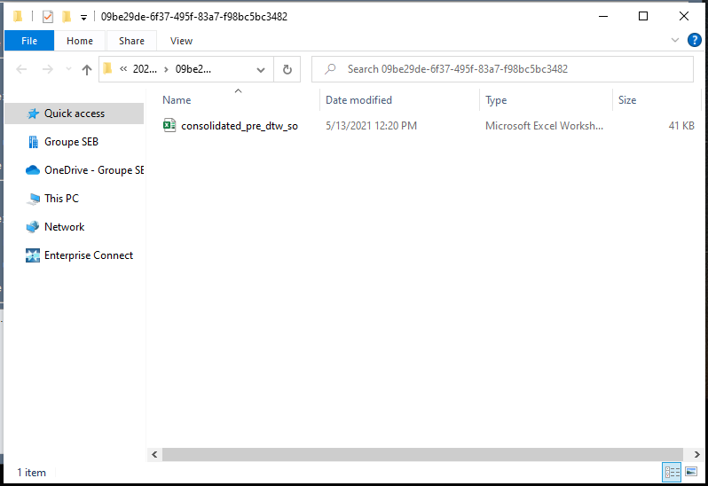
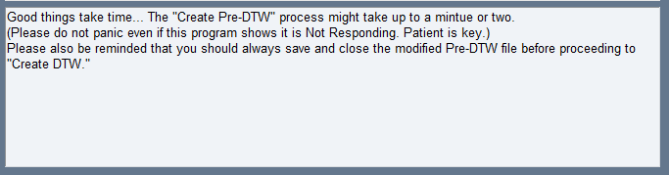
Step 6: Create Pre-DTW
3
Please wait for 5 seconds
1
4
A Pop-up directory will show up containing the Pre-DTW excel file.
2

Slide 30
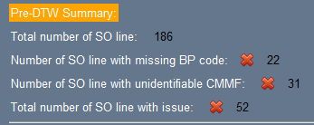
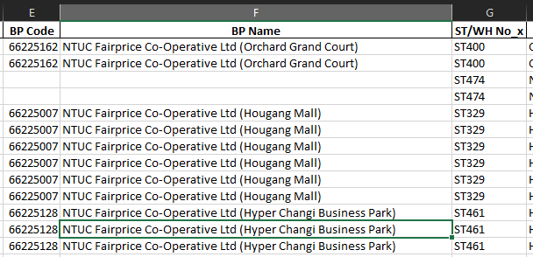

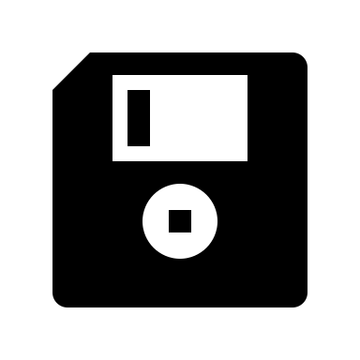

Step 7: Check and Modify Pre-DTW
1
3
Fill in missing information.
2
4
5
Save
Close Pre-DTW*
Remark*: Please DO NOT miss this step! If not done will stop the program from running next step.

Slide 31
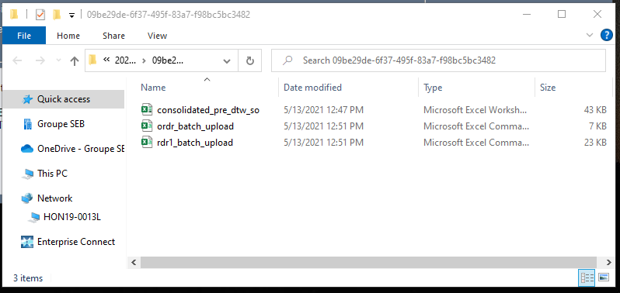
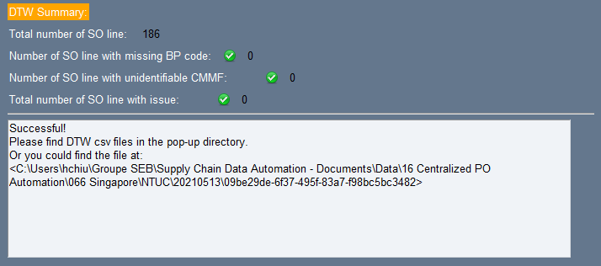
Step 8: Create DTW (Success)
3
1
DTW csv files created.
2
No more missing information.

Slide 32
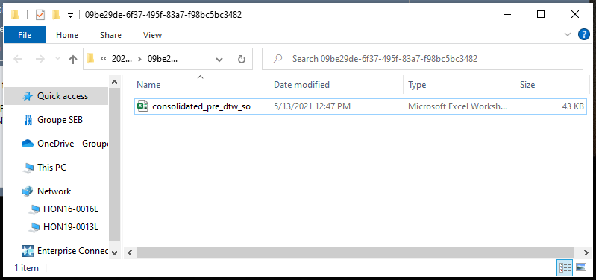
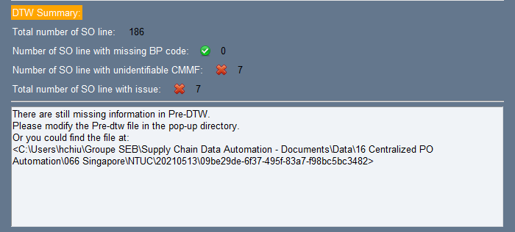

Step 8: Create DTW (Fail)
3
No DTW csv files are created.
1
2
4
There are still missing information in Pre-DTW file.
Go back to Step 7 and re-modify the Pre-DTW.

Slide 33
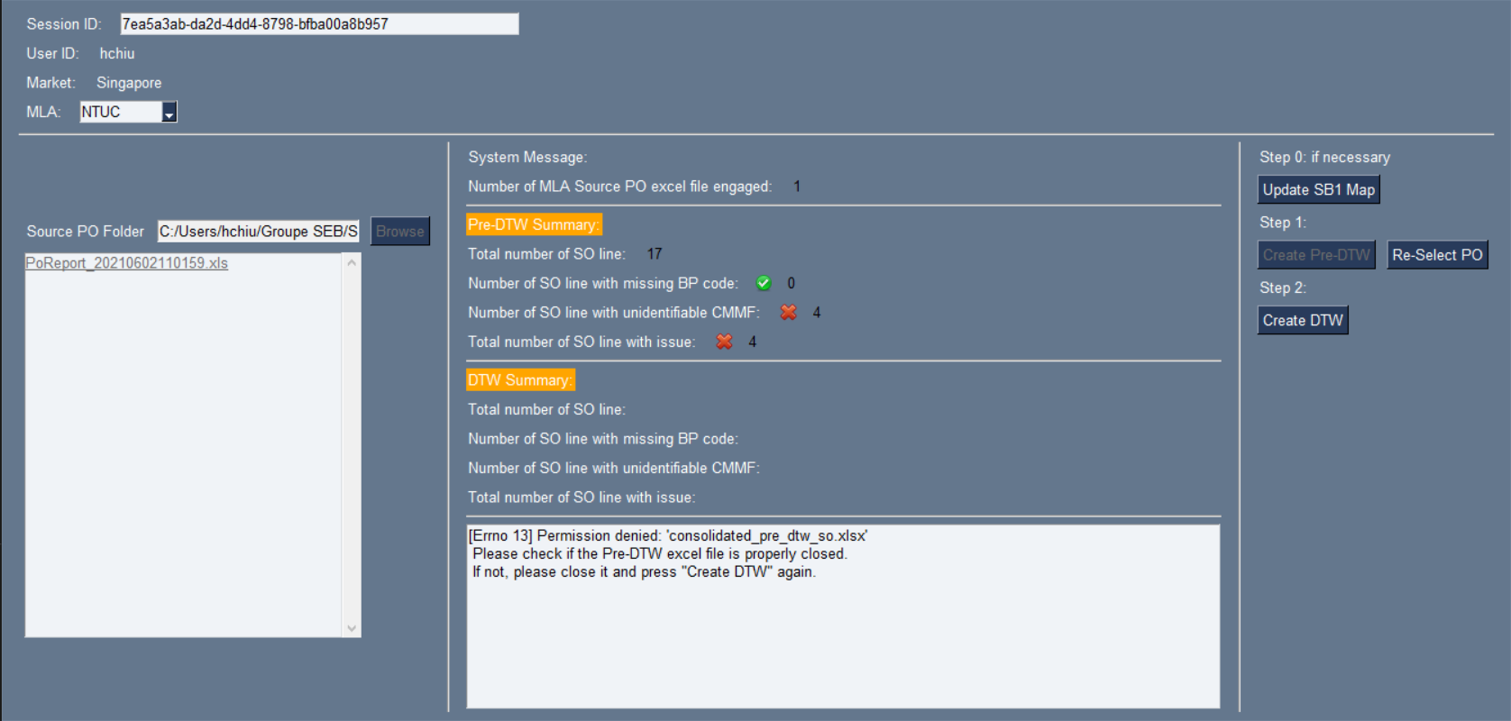
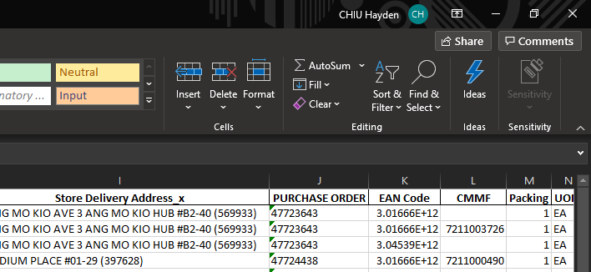
Exceptions Handling
3
1
2
When Source PO files or Pre-DTW file are not properly closed, the system will prompt a reminder message.

